Slide 1
Docker - Manipulate container
Hung.Tran

Slide 2
CONTENT
Docker run in detail
Overriding default commands
List of running containers
Docker lifecycle
Restarting stopped containers
Removing stopped containers

Slide 3
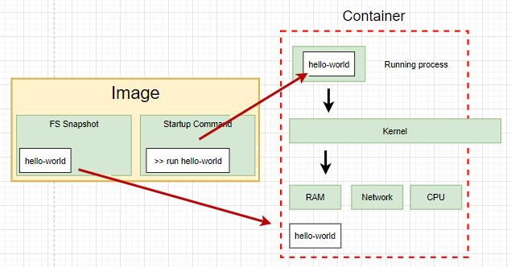
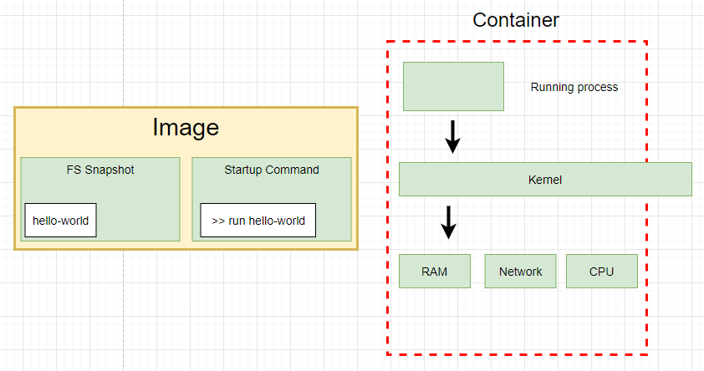
Docker run in detail
docker run hello-world

Slide 4
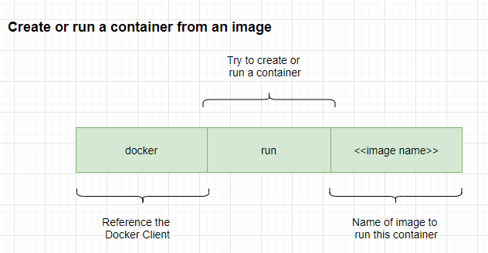
Docker run in detail

Slide 5
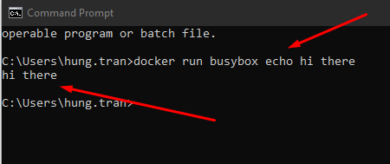
Overriding default commands
Run a command and show message
>> docker run busybox echo hi there
Notes:
we choose busybox becuase it has echo or ls command in its container.
hello-world is a single file container.

Slide 6
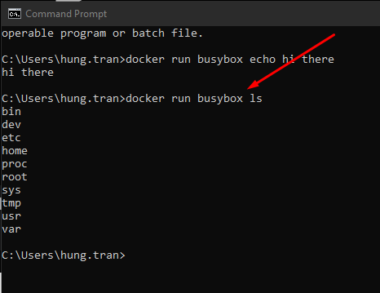
Overriding default commands
Show list of foder of the container
>> docker run busybox ls

Slide 7
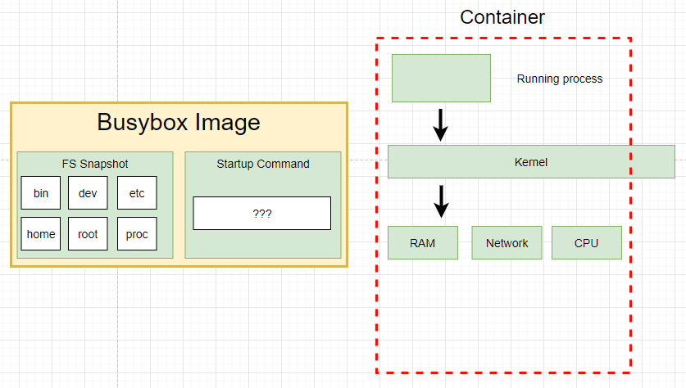
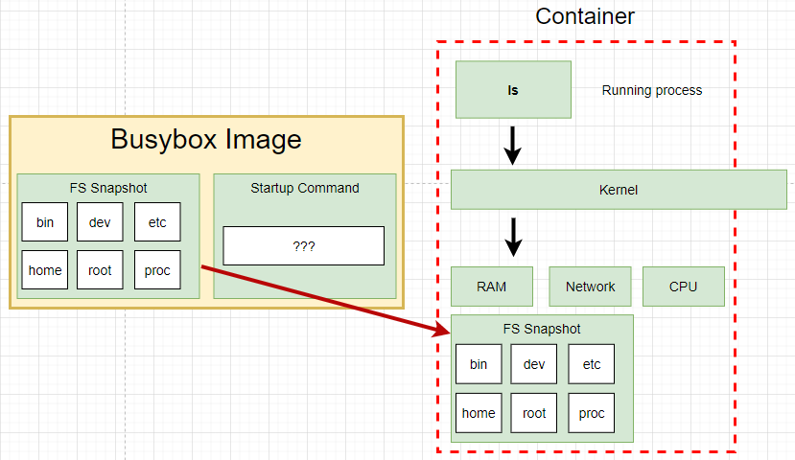
Overriding default commands
Show list of foder of the container
>> docker run busybox ls

Slide 8

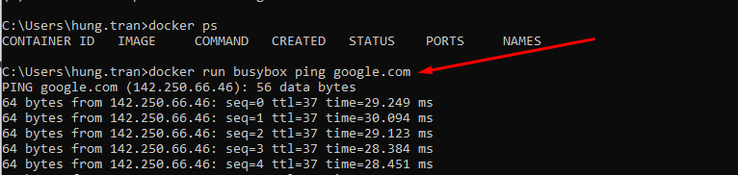
List of running container
Show list of running container
>> docker ps

Slide 9
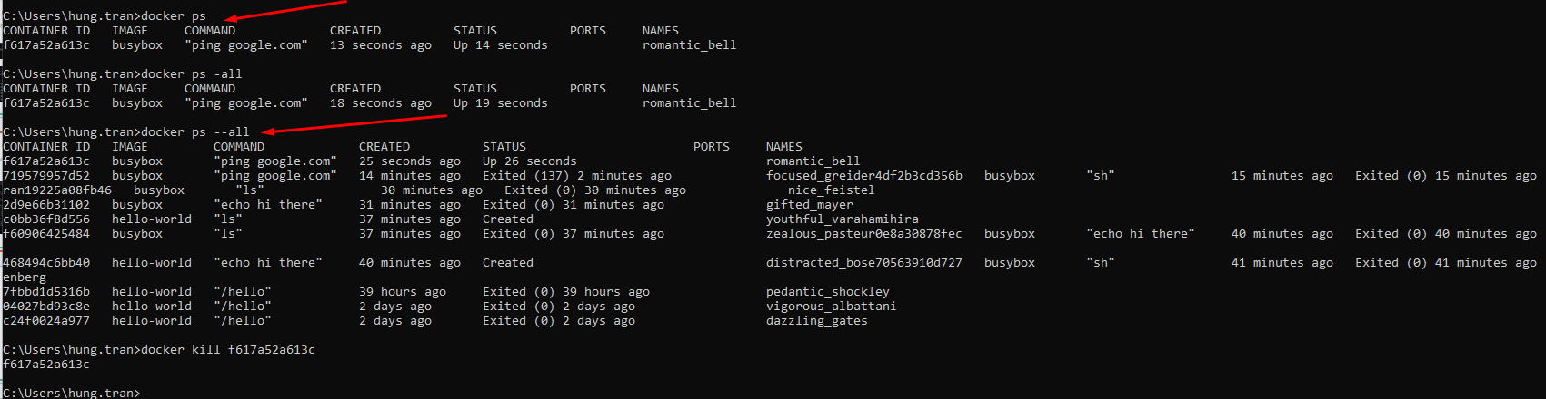
List of running container
Show list of running container
>> docker ps
Show all containers that have ever been created on our machine
>> docker ps --all

Slide 10
Docker lifecycle
docker run hello-world

Slide 11
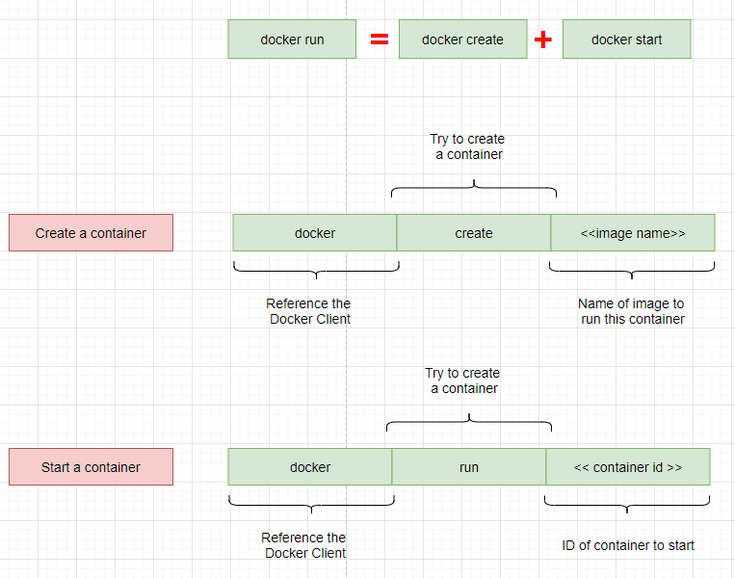
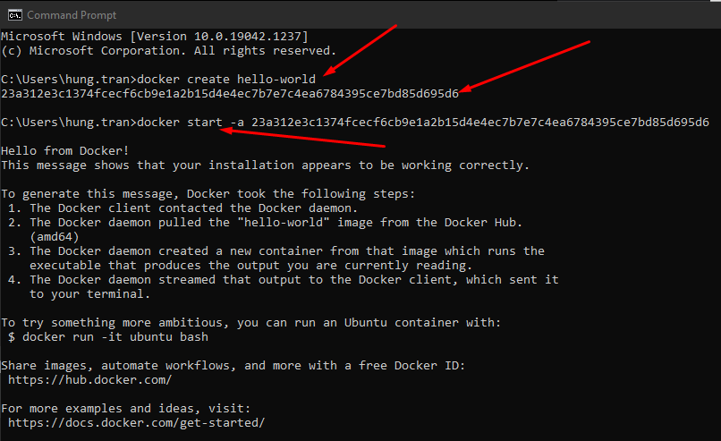
Docker lifecycle
docker run hello-world
Notes:
docker start -a hello-world
-a is a option, let the docker show the output coming from it and print it out at the terminal
docker run
=> is going to show you all the logs or all the information coming out of the container by default

Slide 12
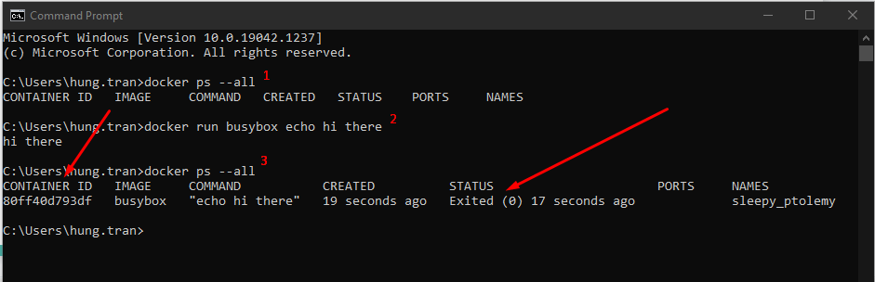
List of containers running
Status = exited, mean it’s instance till exist in the cache, so we can recall it by using its ID
Notes:
check all container are running
>> docker ps --all
run busybox container
>> docker run busybox echo hi there
check all containers are running
>> docker ps --all
Restart a stopped container by using its ID
>> docker start -a ID
If you try to change the default command, it still show error
>> docker start -a ID echo hello

Slide 13
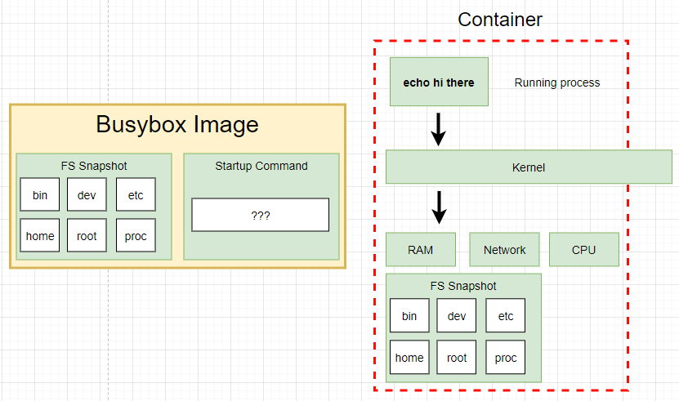
Overring default commands
Notes:
check all container are running
>> docker ps --all
run busybox container
>> docker run busybox echo hi there
check all containers are running
>> docker ps --all
Restart a stopped container by using its ID
>> docker start -a ID
=> When run the container second time, The primary command will start automatically
If you try to change the default command, it still show error
>> docker start -a ID echo hello
=> It will show the error because the current primary command here cannot override

Slide 14
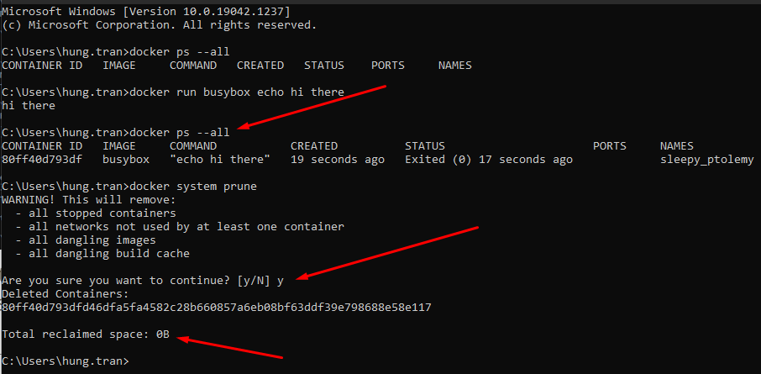
Removing stopped container
docker system prune
=> remove all stopped containers, cache and redownload images from docker hub

Slide 15
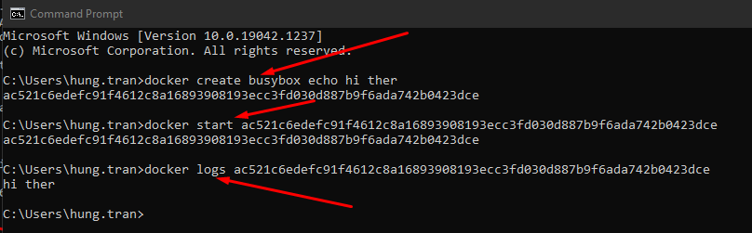
Retrieving log Outputs
docker logs <<container_id>>
=> With this command, we don’t re-run the container again. It only emitted what it works

Slide 16
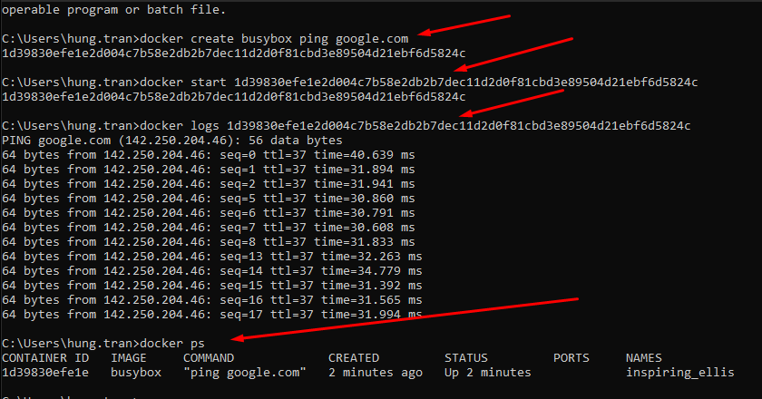
Stopping container
First: create, run and view log of the container

Slide 17
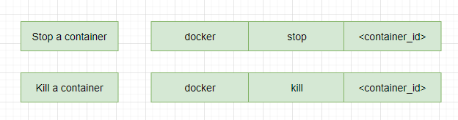
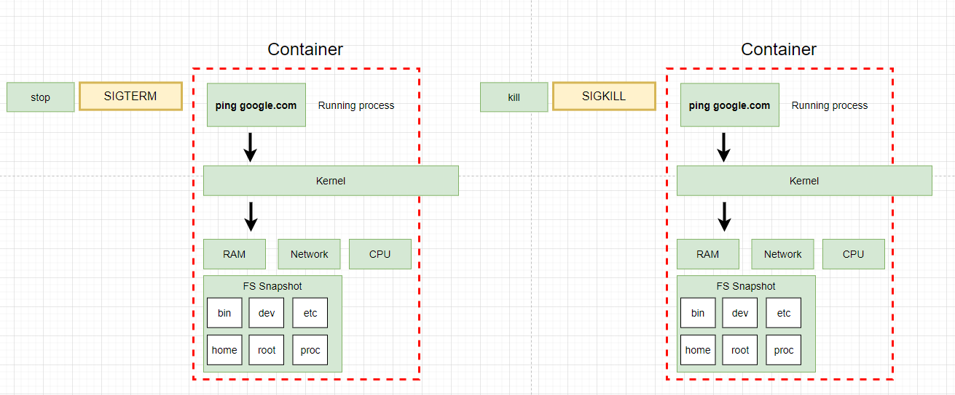
Stopping container
Notes:
stop and kill are used to stop and kill a container. But it has a different
when use stop command, a hardware signal sent to the primary process inside the container (SIGTERM mean terminate signal) to let the container know to shutdown now with a little bit time to clean up the conainer (save files, or emit some messages,...)
- if the container does not stop in 10 seconds, it wil call kill command.
kill command: to sent a signal to the primary container to kill the container immediatelly.

Slide 18
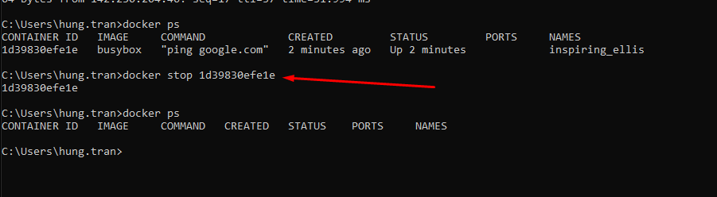
Stopping container
>> docker stop <container_id>
Waiting for over 10 seconds to stop the container

Slide 19
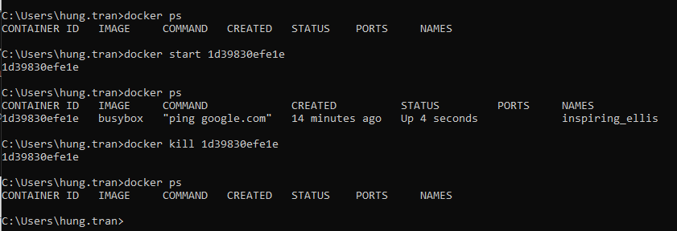
Stopping container
Start container again and use kill command
>> docker kill <container_id>
Stop the container immediately

Slide 20
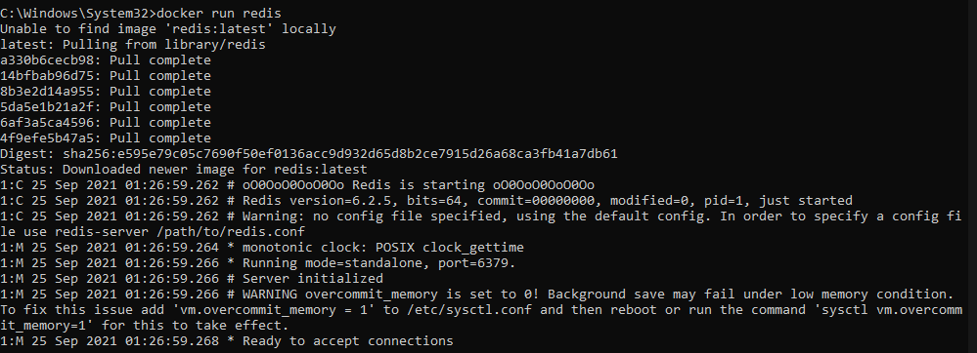
Multi-Command container
First, Settup redis on docker
>> docker run redis

Slide 21
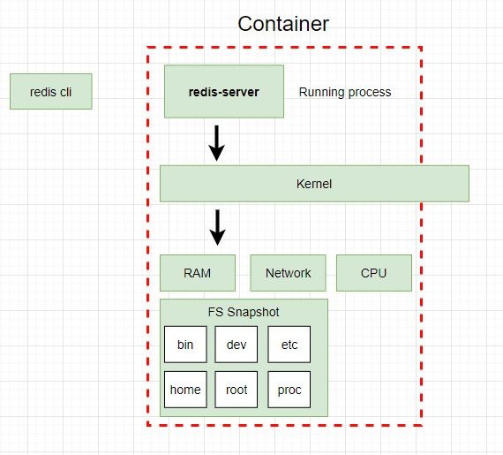
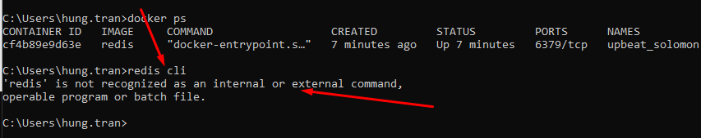
Multi-Command Container
try to run redis-cli but it’s not working because the command run outside the container

Slide 22
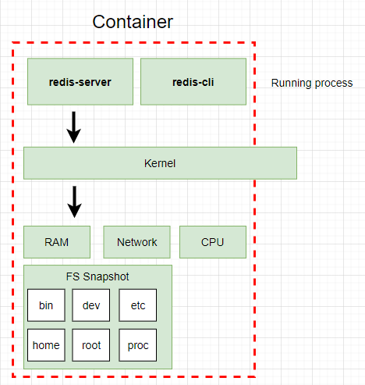
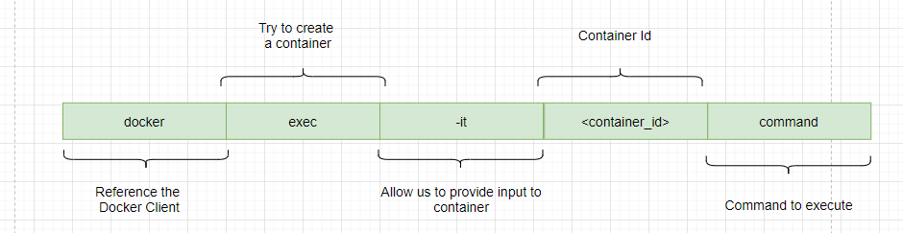
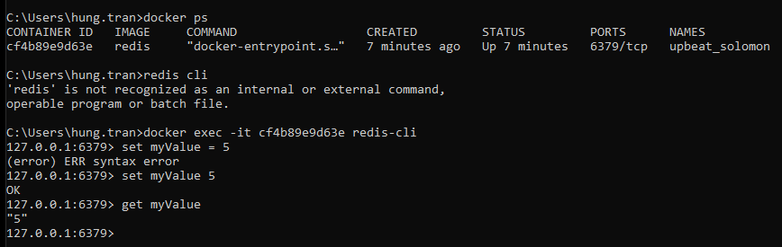
Multi-Command Container

Slide 23
The purpose of the “IT” flag
try to run redis-cli but it’s not working because the command run outside the container
Notes:
When you run a docker in your local machine, every single container that you are running is running inside of a virtual machine running Linux
So these process are really being executed inside of a Linux world, even if you are on Mac or Windows

Slide 24
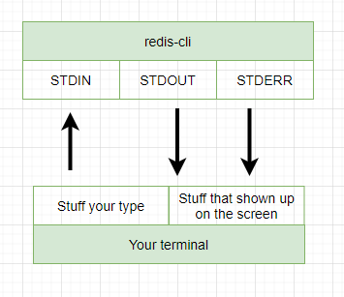
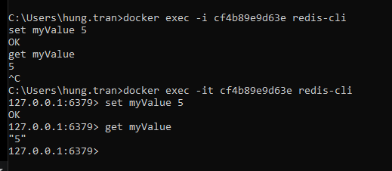
The purpose of the “IT” flag
-i: make sure that any stuff that you type gets direct to STDIN
-t: help to show up the result pretty
Notes:
STDERR: communicate to other outside invironment and return the data and show on the terminal

Slide 25
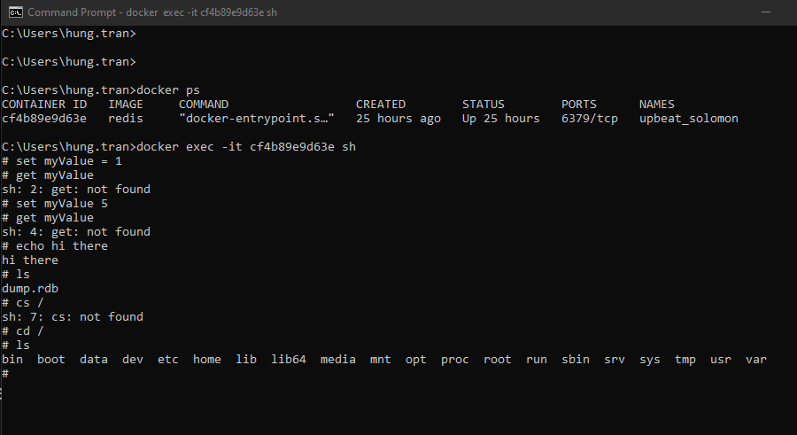
Getting a Command Prompt in a Container
>> docker exec -it <container_id> sh
open a Command Prompt to execute some command

Slide 26
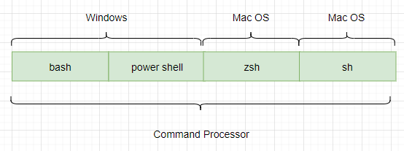
Getting a Command Prompt in a Container
>> sh
Is a name of a program and it’s a program that has been executed inside of that container
Open a Command Prompt to execute some command inside a container

Slide 27
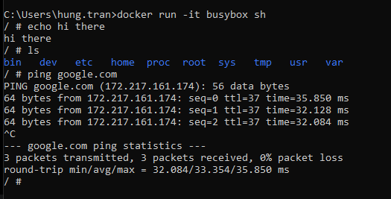
Starting with a Shell
>> docker run <image_name> --it sh
Start a new shell when run new container

Slide 28
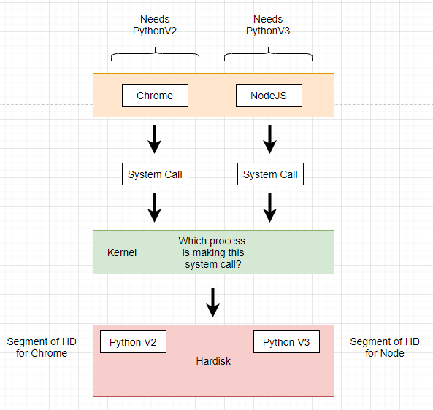
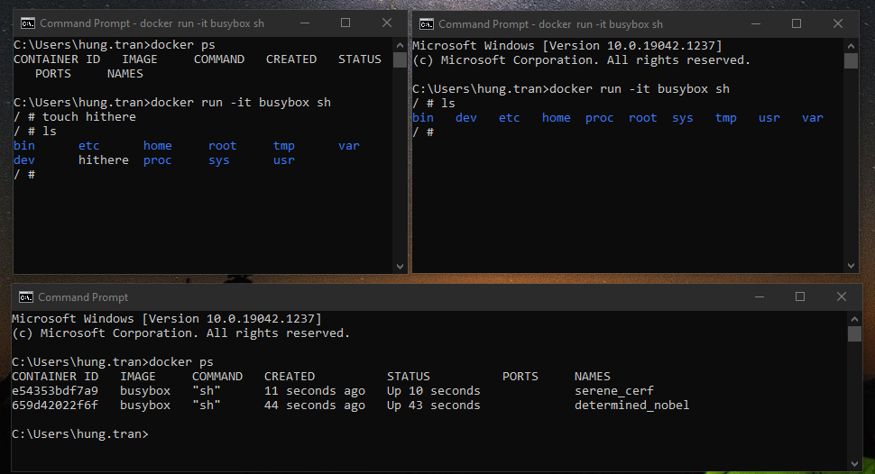
Starting with a Shell
Notes:
run two commands are the same to check its container are shared folder or not

Slide 29
THANKS FOR LISTENING

